Slide 1
Module: Reverse Engineering
Data Access
Yan Shoshitaishvili
Arizona State University

Slide 2
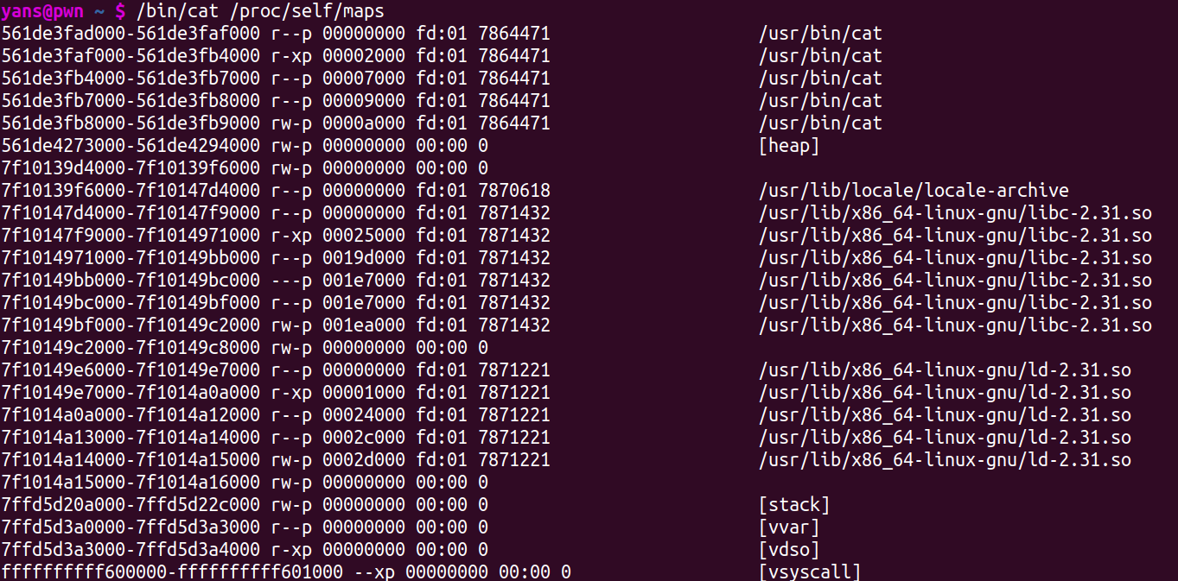
Programs operate on data
Data can be in:
.data: used for pre-initialized global writable data (such as global arrays with initial values)
.rodata: used for global read-only data (such as string constants)
.bss: used for uninitialized global writable data (such as global arrays without initial values)
stack: used for statically-allocated local variables
heap: used for dynamically-allocated (malloc()ed) variables. We'll explore this in-depth later in the course!
Let's look at how this data is accessed!

Slide 3
Accessing data on the stack
Data on the stack is generally accessed via:
push (to store data on "top"/left of the stack)
pop (to retrieve data from the "top"/left of the stack)
rsp-relative accesses:
load: mov rdx, [rsp+0x10]
store: mov [rsp+0x10], rdx
offsets are positive because rsp points to the left edge of the function frame
rbp-relative accesses:
load: mov rdx, [rbp-0x10]
store: mov [rbp-0x10], rdx
offsets are negative because rbp points to the right edge of the frame!
via reference
mov rdx, rsp; mov [rdx], 0x41;
mov rdx, rbp; mov [rdx], 0x41;
stack ........
rbp-0x28
rsp
rbp-0x20
rsp+0x8
rbp-0x18
rsp+0x10
rbp-0x10
rsp+0x18
rbp-0x8
rsp+0x20
saved rbp
return address

Slide 4
Accessing data in ELF sections
Data in .bss, .rodata, and .data is stored at known offsets from the program code (in the ELF data sections!).
It is accessed via rip-relative instructions.
Load: mov rax, [rip+0x20040]
Store: mov [rip+0x20040], rax
Reference: lea rax, [rip+0x20040]

Slide 5
Accessing data on the heap
Pointers to heap data are generally stored in memory or on the stack.
Mind the difference between:
Stack data access:
mov rax, rsp
mov rdx, [rax]
Arbitrary data access via stack-stored reference:
mov rax, [rsp]
mov rdx, [rax]
stack
rbp-0x28
rsp
stack
rbp-0x28
rsp
arbitrary data

Slide 6
Data Structures
Type information is lost in the compilation process! You will have to piece type information together based on how data is used by code.

